Slide 1

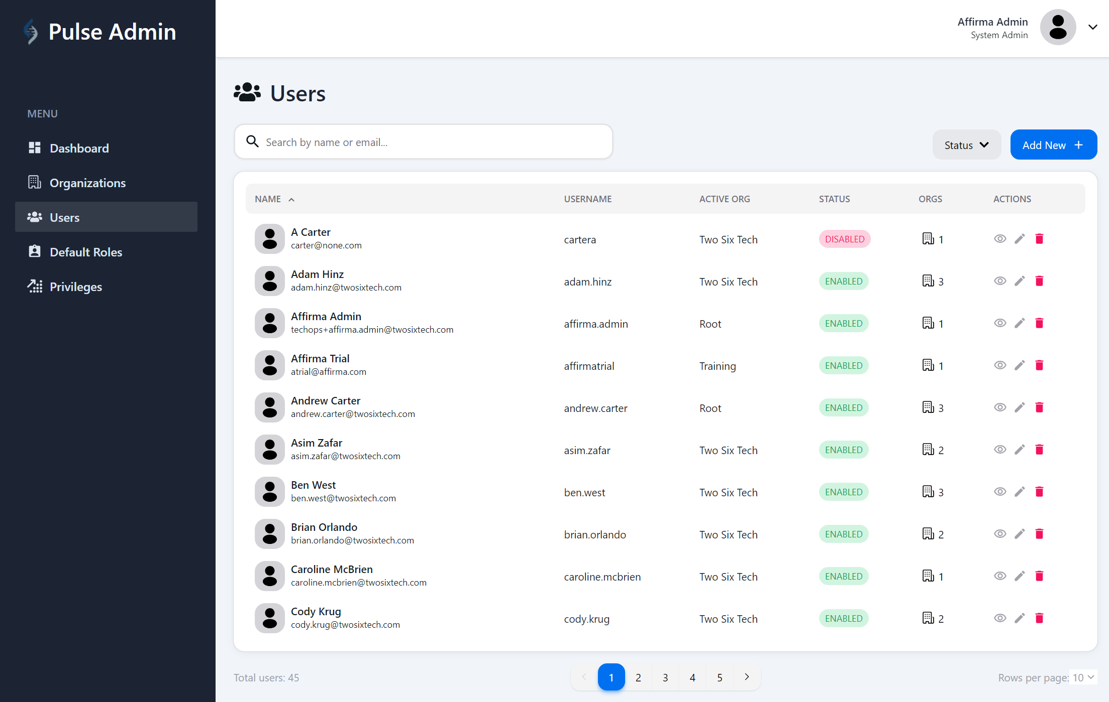
TwoSix Technologies
Business Need
TwoSix aimed to develop an Admin SSO Portal for their product, Pulse. This portal empowers Admins and Site-Admins to efficiently set up their teams with the necessary access permissions, streamlining the process and eliminating the need for lengthy email exchanges and support requests.
What We Did
Affirma, in collaboration with TwoSix technical team, designed and developed the Admin SSO Portal leveraging Java, React, GraphQL & Postgres technologies.
Ability to manage Organizations, Users, Roles & Privileges
Integrate the data to Key Cloak which is utilized by other systems as IDP
Built additional insights on tracking User Activity and dormant accounts
Capability for multi-org/multi-role needs.
User-friendly UI/UX designed for ease of use and efficiency.
Results
V1 of the Portal went live early 2024 and has been actively used by the admin team
V2 of the portal enhancements were awarded to Affirma and is being worked on.

